Slide 1
U.S.A.
2016 Presidential Election Clusterability Analysis
Linfeng Wang

Slide 2
Introduction
Why Choose this dataset?
Why conducting unsupervised learning analysis?

Slide 3
Introduction
The two political parties in the U.S.: Democrat and Republican have really distinct ideologies that are performed in many way.
Tax Difference:
Democrat party claim to minimum wages and progressive taxation, while republican party believe tax shouldn’t be increased for anyone.
In Broward county in Florida, the food in the restaurant was taxed at a rate of 7%.
In Champaign, Illinois, the food tax rise to 11%. I think this might be result from different political preference about taxation of the two counties.
Therefore, in this case study, we want to find if there exists a clear pattern in the way counties vote for different political parties.

Slide 4
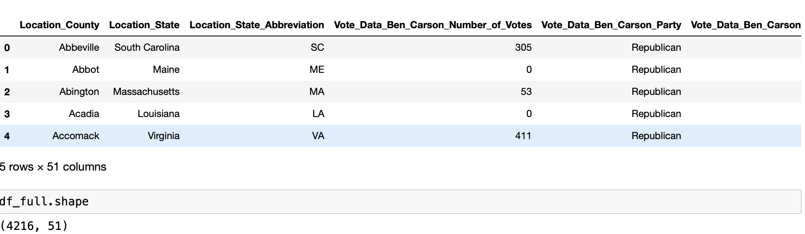
Dataset overview
Contains: Counties, States, number of votes for each candidates, percentage of votes for each candidates in each party*, party the candidate belonged to

Slide 5
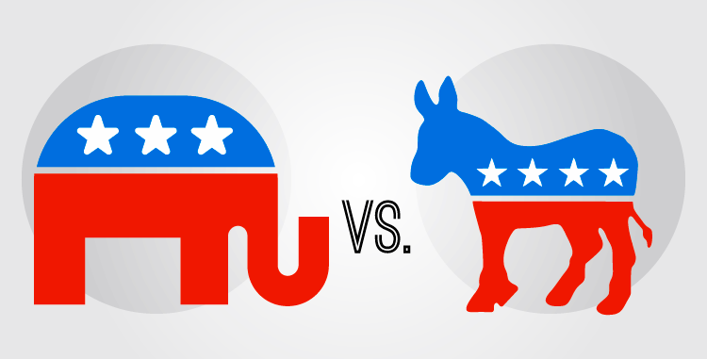
Why Unsupervised learning?
Large dataset
Analyze patterns between each object, and identify the similarities that are not shown directly at a glimpse.
No clear class labels

Slide 6
Data Manipulation
Data Cleaning
Data Manipulation

Slide 7
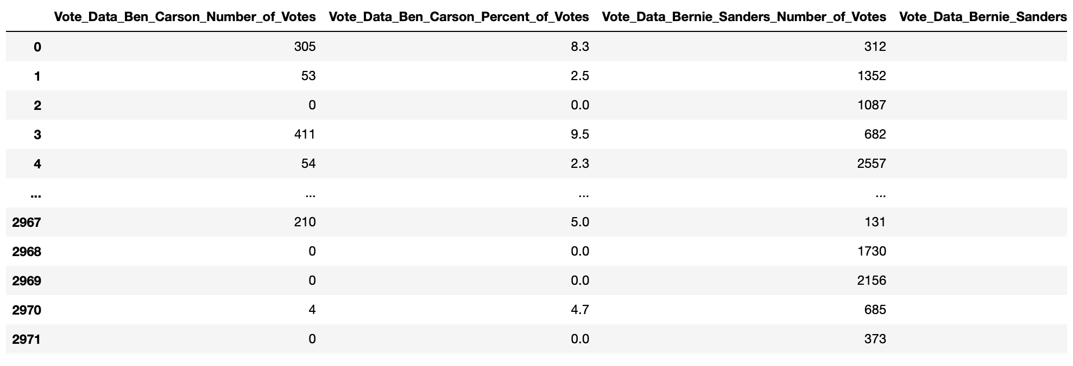
Data cleaning
Cleaning Criteria:
1. Drop counties that have less than 1000 total vote.
2. Drop NA values
After cleaning: We have 2972 rows
Notes:
Next, we want to construct a dataframe with only total number of votes. So that we can drop the counties that have fewer votes. Say drop the counties that have less than 1000 votes.

Slide 8
Data Manipulation
Want to find: The percentage of a particular candidate's weight compare to all other candidates in a specific county.
Finding Criteria: If one party has more than 50% of the vote in one county, then that county is considered embracing that party.
Republican:
Ted_Cruz
Ben Carson
Carly Fiorina
Chris Christie
Donald Trump
Jeb Bush
Democrat:
Bernie Sanders
Hillary Clinton
Martin O'Malley
John Kasich
Marco Rubio
Mike Huckabee
Rand Paul
Rick Santorum
Notes:
Want to find: The percentage of a particular candidate's weight compare to all other candidates in a specific county. Need to divide each entree by the total number of vote for each county.
Republican = {"Ted_Cruz", "Ben Carson", "Carly Fiorina", "Chris Christie", "Donald Trump", "Jeb Bush", "John Kasich", "Marco Rubio", "Mike Huckabee", Rand Paul, Rick Santorum }
Democrat = {"Bernie Sanders", "Hillary Clinton", "Martin O'Malley" }

Slide 9
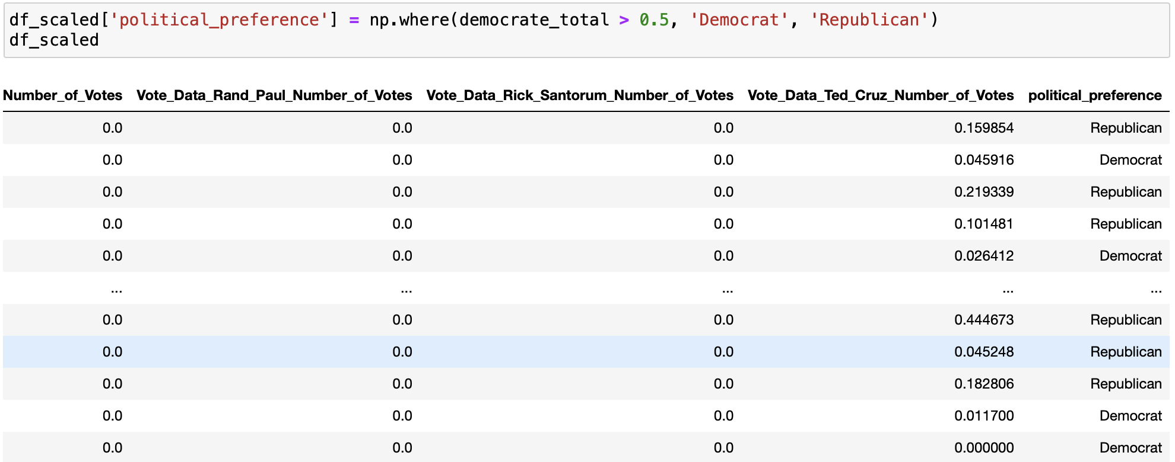
Data Manipulation
Add Class label “Political Preference”
Notes:
Based on criteria, construct a new column of class label of political preference.

Slide 10
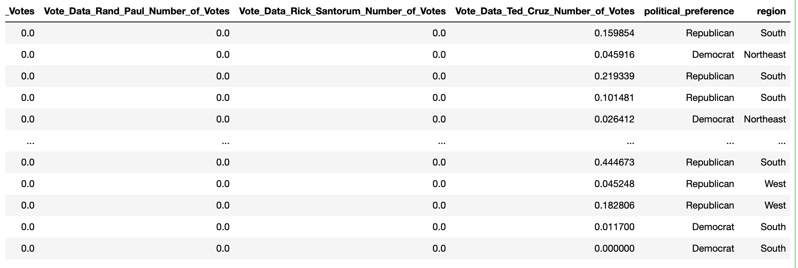
Data Manipulation
According to The US Census Bureau: Four regions in the US:
the Northeast, the Midwest, the South, and the West.
Notes:
We could also add a column of region of these county and see if we can do sth with it in further analysis

Slide 11
Clustering Structure

Slide 12
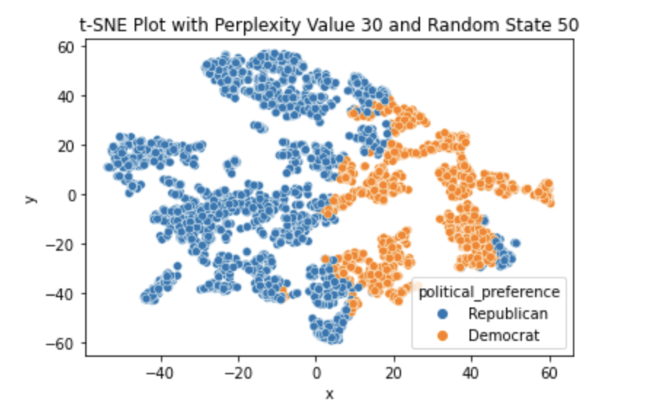
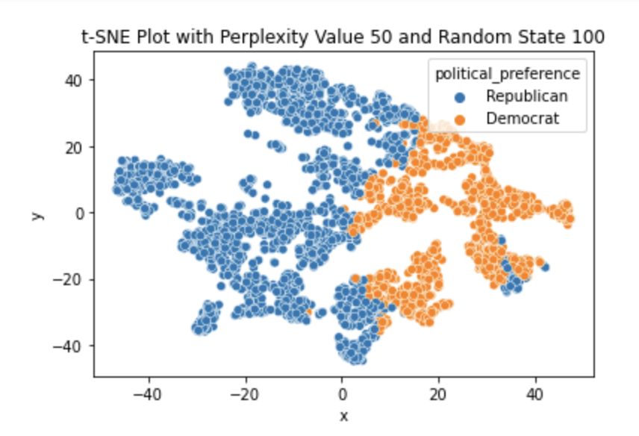
T-SNE Visualization

Slide 13
Clusterability
At least 6 - 7 distinct main clusters for multiple random state ande perplexity value pairs
Main cluster are in spherical shape, but not too well-separated and well- balanced in size
Exist overlapping clusters and “Straddle nodes”

Slide 14
Algorithm Selection

Slide 15
Algorithm Selection
Let’s look back what we have:
Want to Find: Voting pattern of two parties for each county
About same number of objects in each cluster
Cluster are spherical
Straddle notes exist
Want to Try: K-mean algorithm
Improve by: Fuzzy c-means algorithm
Notes:
Since my dataset is about voting and there's two parties: Democrat and Republican. My first thought is performing k-mean algorithm. Also, in section 5, by visualizing the dataset using plotting t-SNE algorithm, I found our dataset is clusterable which means this dataset is suitable by using k-mean clustering algorithm as it clustering by euclidean distance. From the scatter plot, Each cluster has about the same number of objects, and clusters are spherical and have the same sparsity. Also objects are not perfectly well seperated which might be a drawback of performing k-mean algorithm. We could give it a try.
However, since some objects are not 100% belong to one particular cluster from TSNE plot. There are some overlapping clusters. To better detect these, performing fuzzy c-mean clustering algorithm will be a good choice.
Therefore, My final choices are:
**1. K-mean Clustering algorithm**
**2. Fuzzy c-means Clustering algorithm**

Slide 16
K-Means Clustering

Slide 17
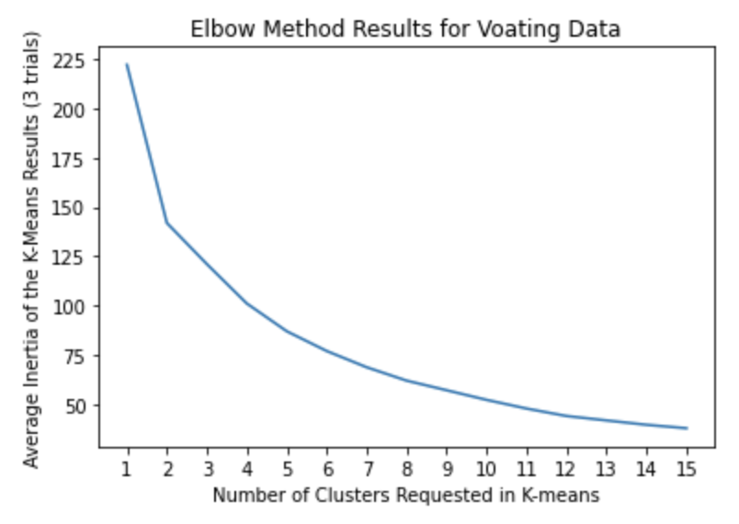
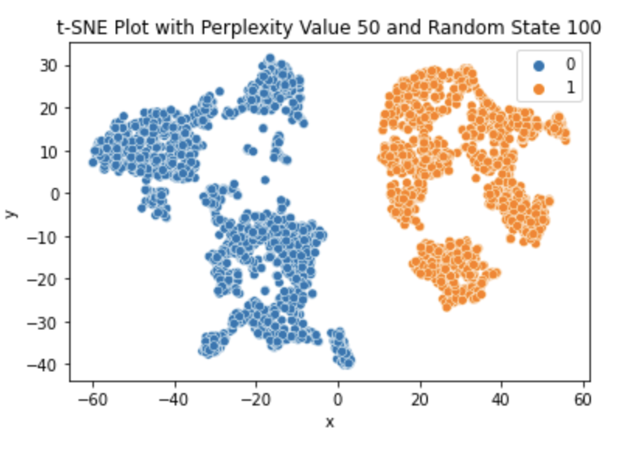
K-means Result Display
K = 2

Slide 18
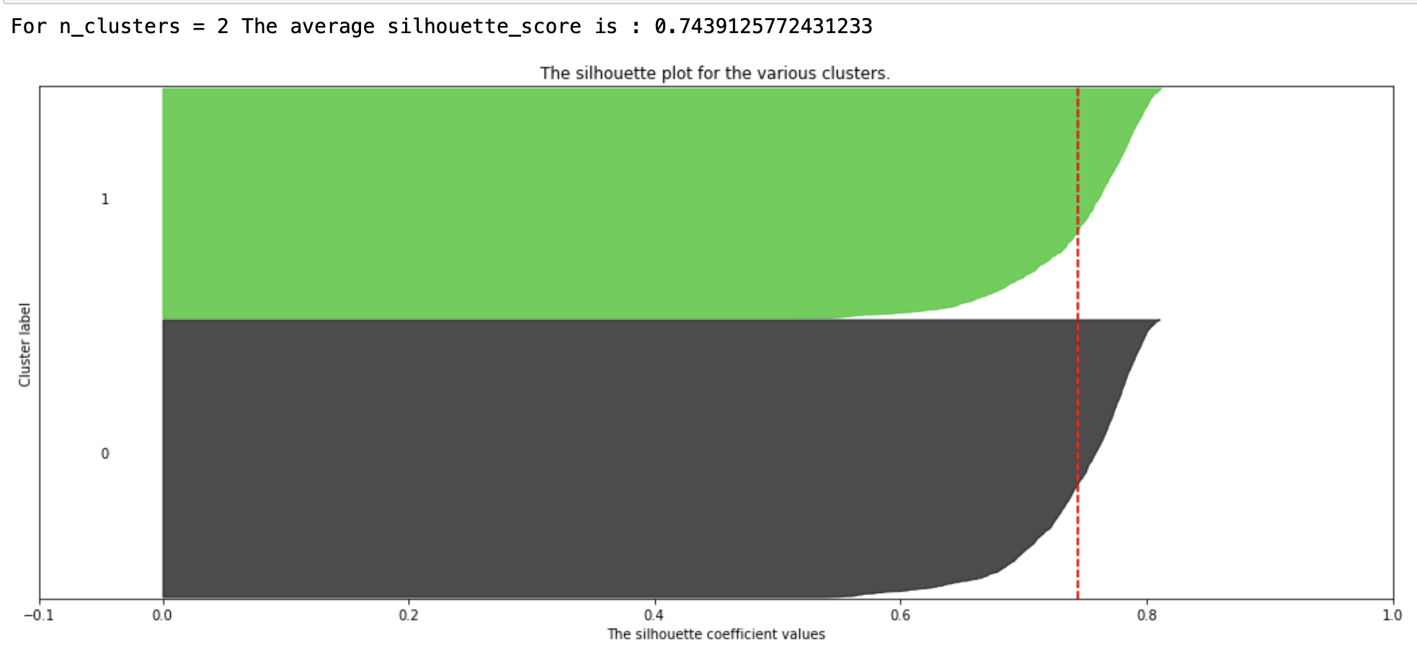
Post-Cluster Analysis
Notes:
`\Cluster 0 and 1 have about the same amount of cohesion and separation as their shapes are about the same. They also look like they have about the same number of objects assigned to the cluster. Also, clustering by k = 2 give us a relative high silhouette_score, meaning the clusters are well separated and cohesive.`\

Slide 19
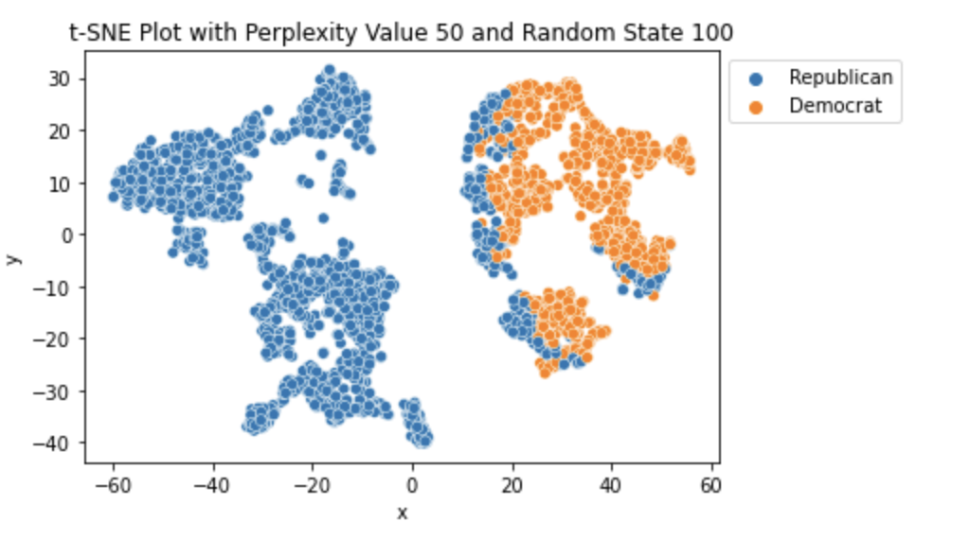
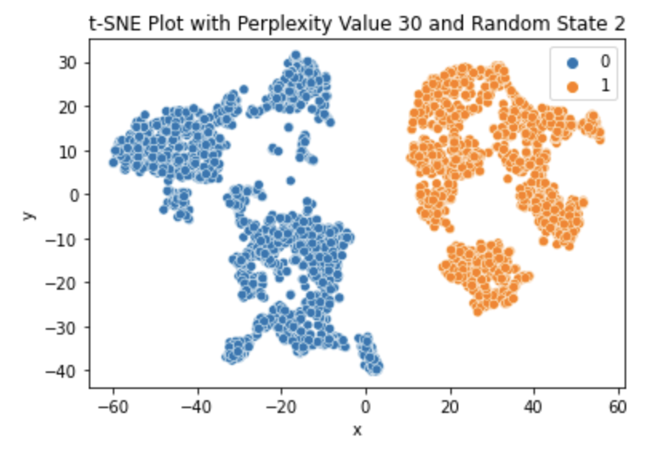
Post-Cluster Analysis
Adjusted Rand Score: 0.59 Homogenous Score: 0.56 Completeness Score: 0.6
Notes:
**Conclusion:** As the plots shows, it matches with my homogeneity score, and the completeness score since each of the k-means clusters are relatively homogenous with respect to the the class labels, however, a small portion of republican label goes beyond of its main clusters, indicating republican label is less completely together in a single cluster, resulting in lower the Completeness score.

Slide 20
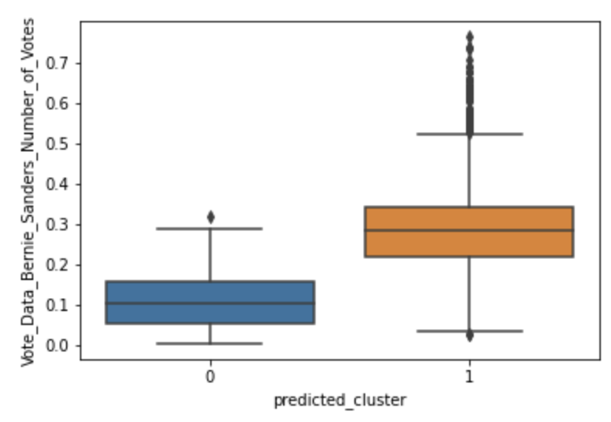
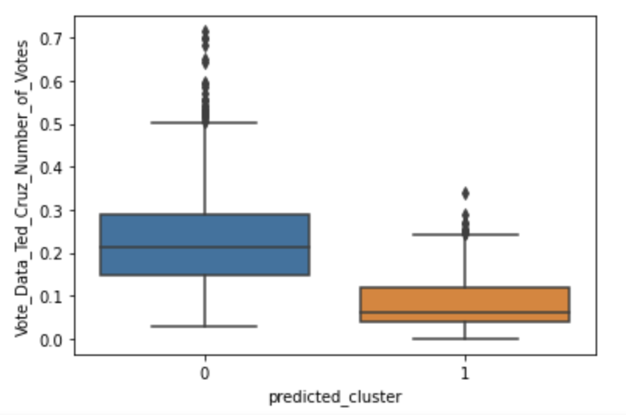
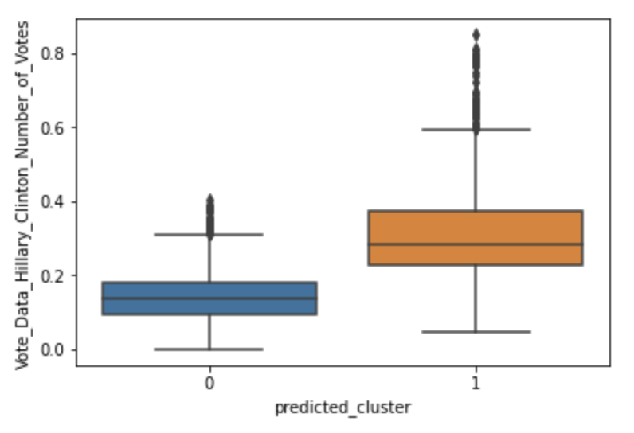
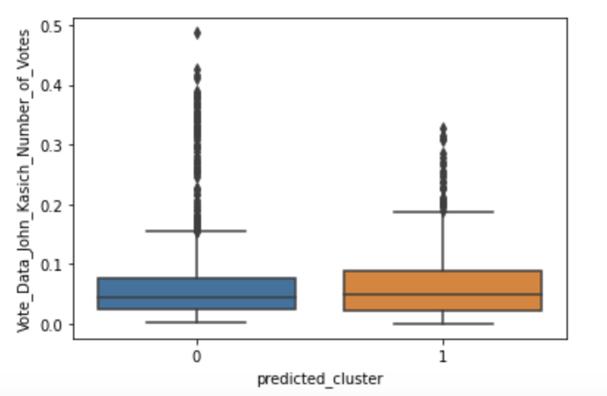
Post-Cluster Analysis
Cluster 0 prefer more to: Ben_carson, Donald_Trump, Marco_Rubio, Ted_Cruz
2. Cluster 1 prefer more to: Bernie_Sanders, Hillary_Clinton
3. Swing Candidate: John_Kasich is preferred by both clusters.

Slide 21
Fuzzy C-means Clustering

Slide 22
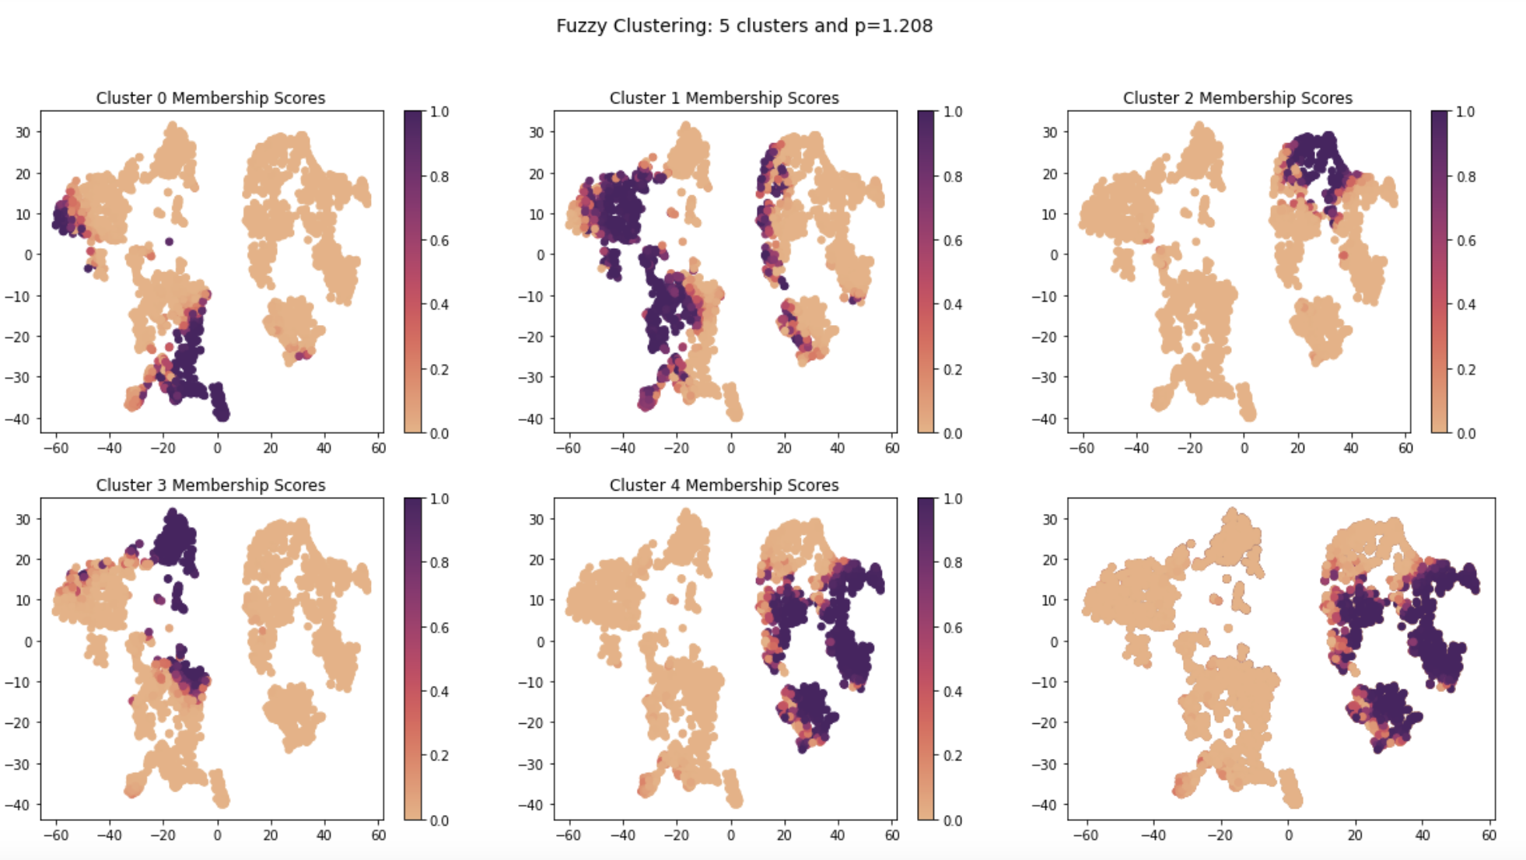
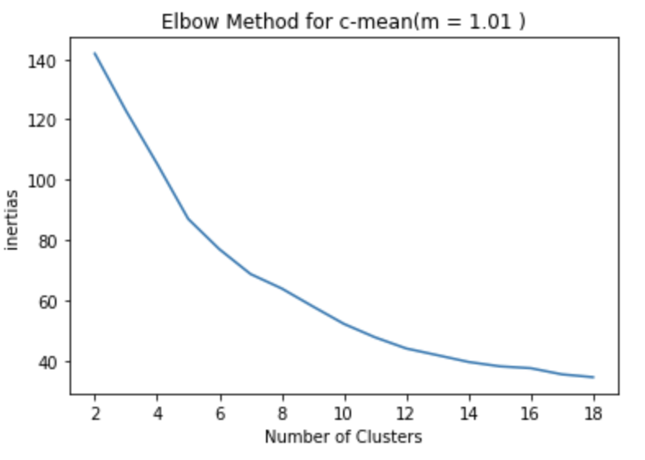
Fuzzy c-means Result Display
C = 5
P = 1.208
Ndpc = 0.87

Slide 23
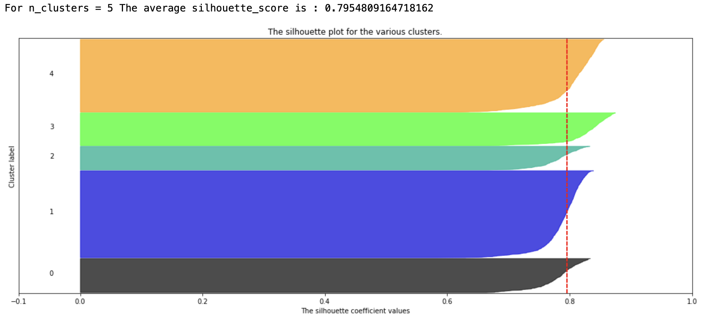
Post-Cluster Analysis

Slide 24
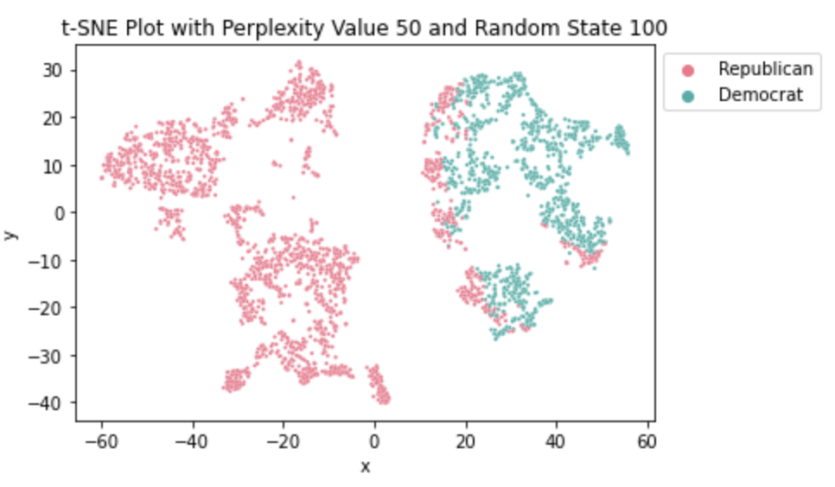
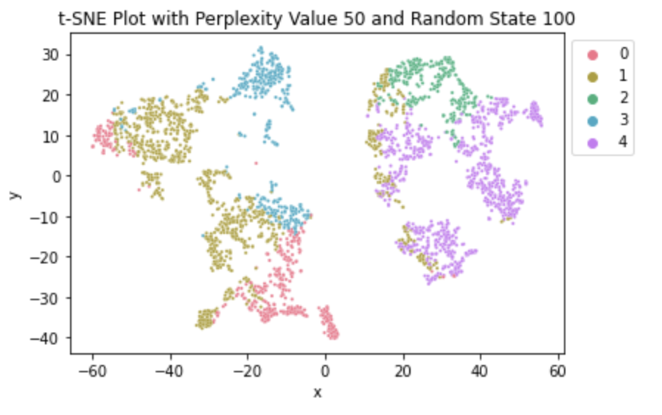
Post-Cluster Analysis
Adjusted Rand Score: 0.33 Homogenous Score: 0.32 Completeness Score: 0.74

Slide 25
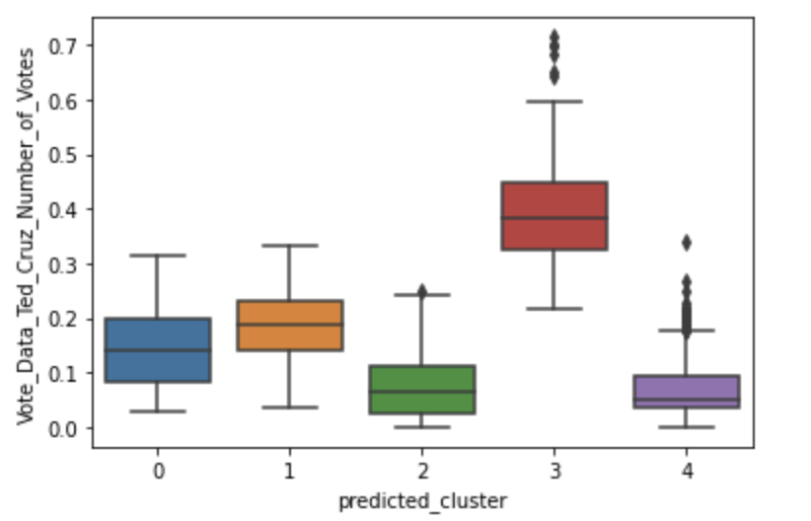
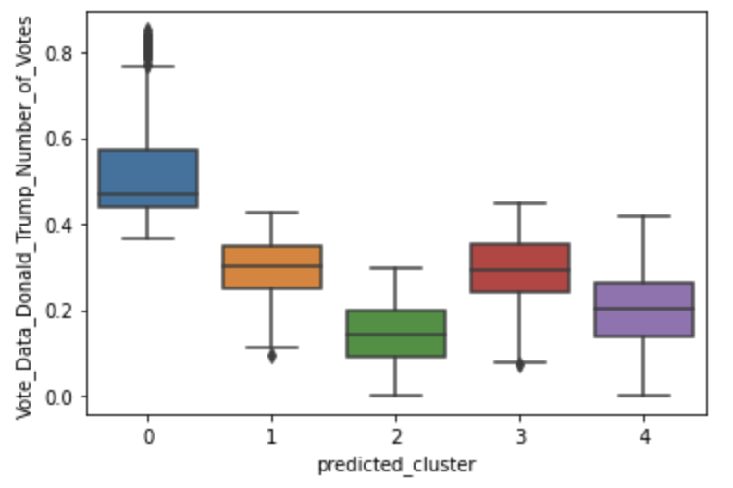
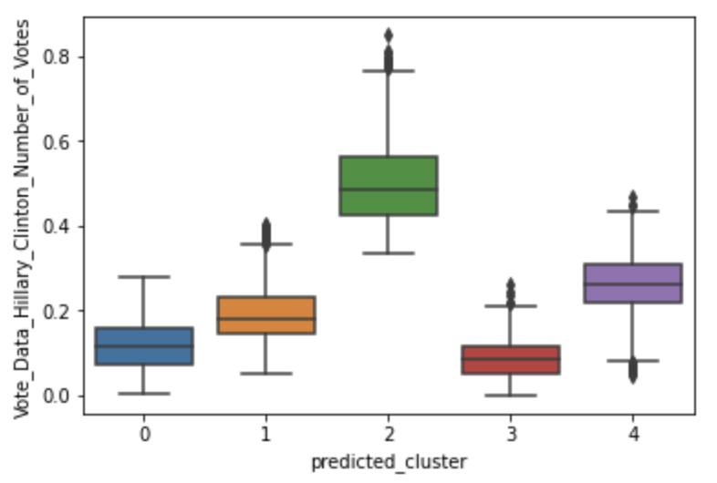
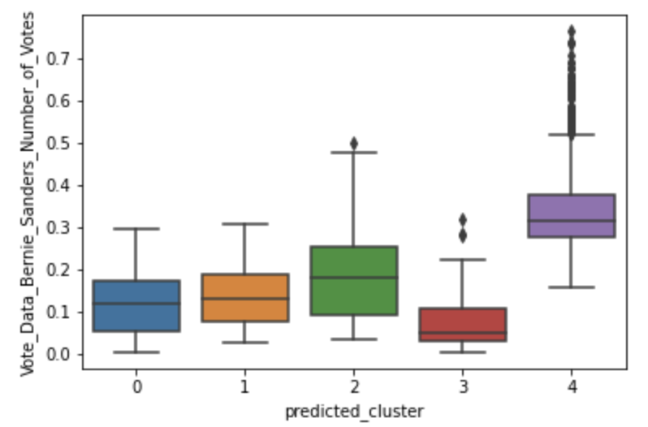
Post-Cluster Analysis
* Cluster 4:
- Most prefer: Bernie_Sanders
- Least prefer: Ted_Cruz
* Cluster 3:
- Most prefer: Ted_Cruz
- Least prefer: Hillary_Clinton
* Cluster 2:
- Most prefer: Hillary_Clinton
- Least prefer: John_Kasich, Donald_Trump
* Cluster 1:
- Does not perfer or disperfer any candidate.
* Cluster 0 :
- Most prefer: Donald_Trump
- Least prefer: Marco_Rubio

Slide 26
Analysis Summary

Slide 27
Algorithm Comparison
K-Means V.S. Fuzzy C-means
2 clusters
Rand score: 0.59
Homogenous Score: 0.56
Completeness Score: 0.6
Silhouette score: 0.74
5 clusters
Rand Score: 0.33
Homogenous Score: 0.32
Completeness Score: 0.74
Silhouette score: 0.79

Slide 28
Conclusion
The k-mean algorithm answers the research question better. — There is a clear pattern of voting for both party among all states in the US.
But the rand score, homogenous score and completeness score are all about 0.5 as suggested by k-means. Not close to 1.
Problem: Ambiguous Criteria of creating class labels “Political_Preference”

Slide 29
Work Cited
Abadi, Mark. “Even the US Government Can't Agree on How to Divide up the States into Regions.” Business Insider, Business Insider, www.businessinsider.com/regions-of-united-states-2018-5.
“Religious Landscape Study.” Pew Research Center's Religion &amp; Public Life Project, Pew Research Center, 13 June 2022, www.pewresearch.org/religion/religious-landscape-study/compare/party-affiliation/by/region/.
Whitcomb, Ryan. “Political News, Analysis and Opinion | CNN Politics.” CNN, Cable News Network, www.cnn.com/election/primaries/counties/va/Dem.

